Slide 1
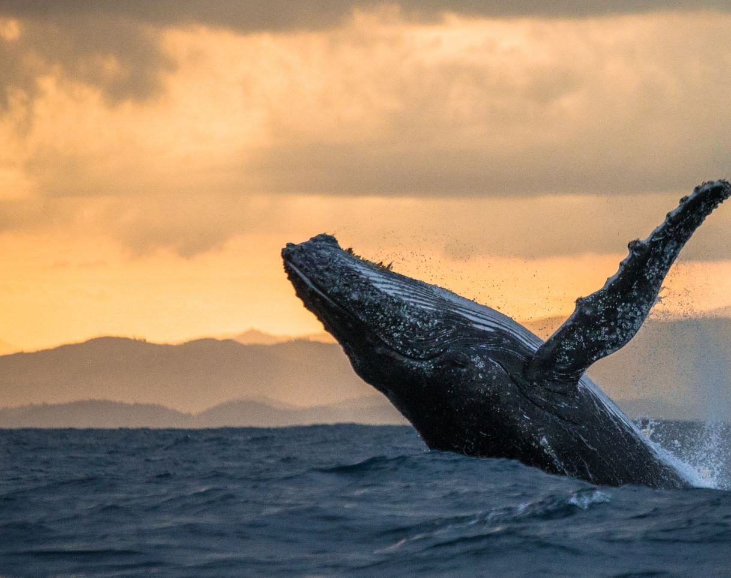
Web UI Design Presentation
The World of Whales by Liam Treacy (C00298242) Jessica Curran (C00300855) Mikey Holmes (C00300796)

Slide 2
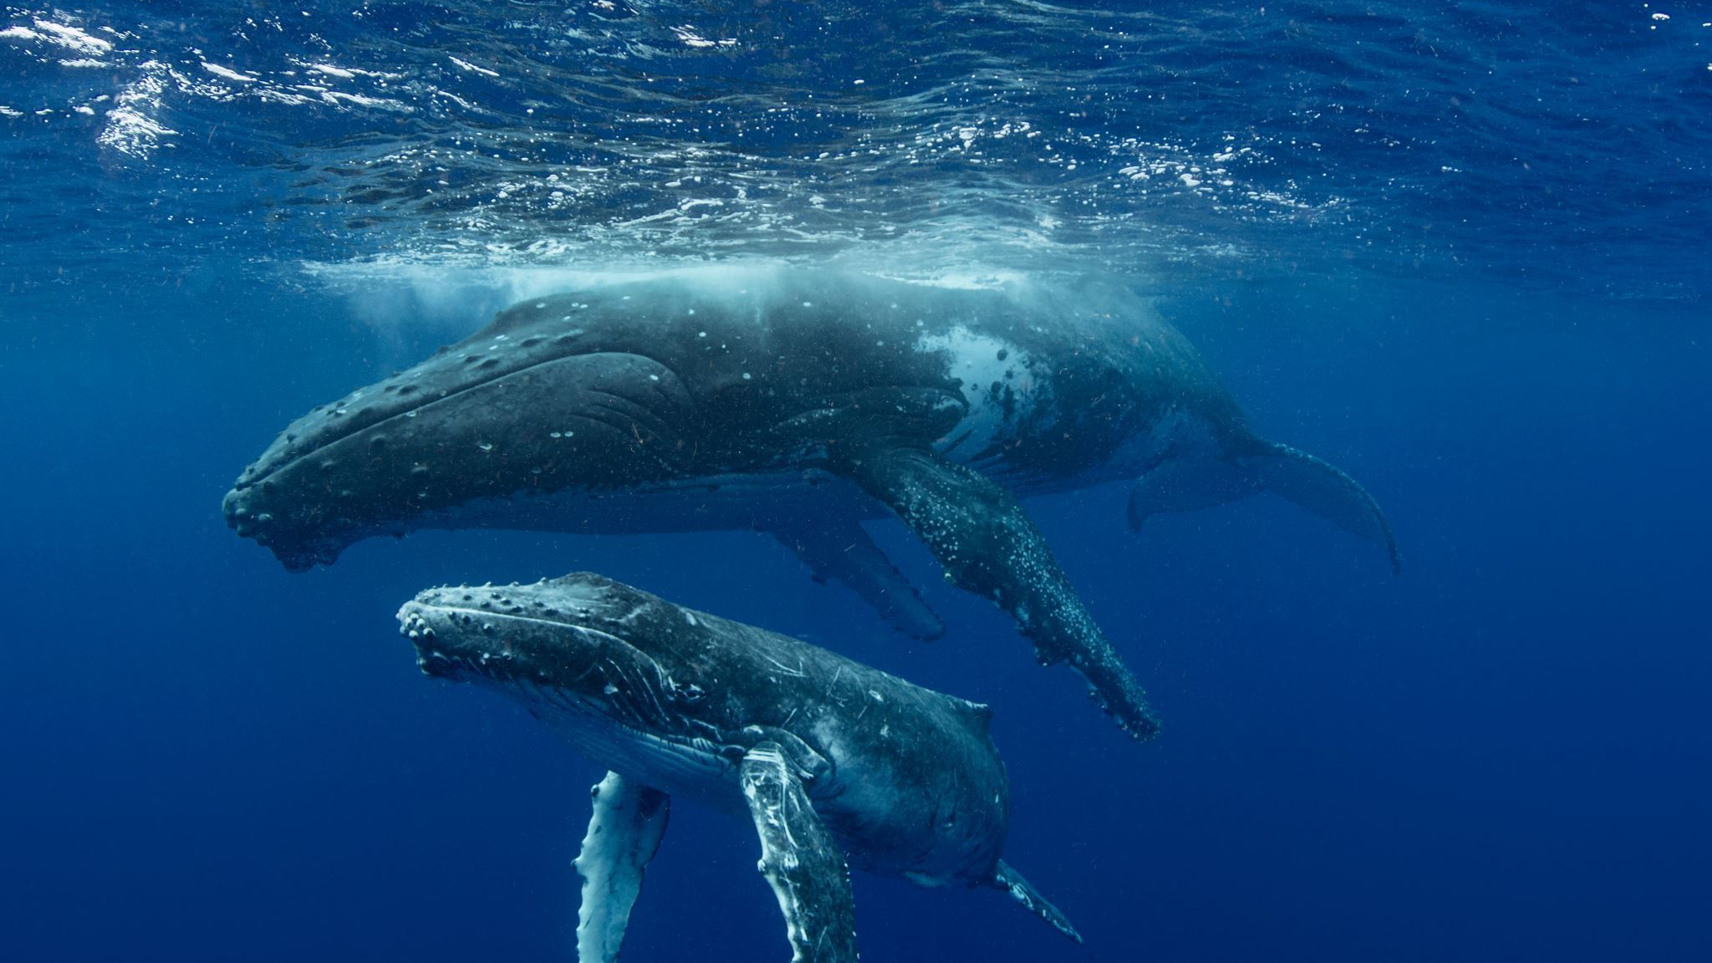
So what is The World of Whales??
The World of Whales is our News Article website, The purpose of our website is to have clear and concise articles, that are free to read and show accurate information to our users,. We chose Whales as our topic because we thought it would be a fun challenge, it also had a unique factor as not many other sites cover Whales solely.

Slide 3
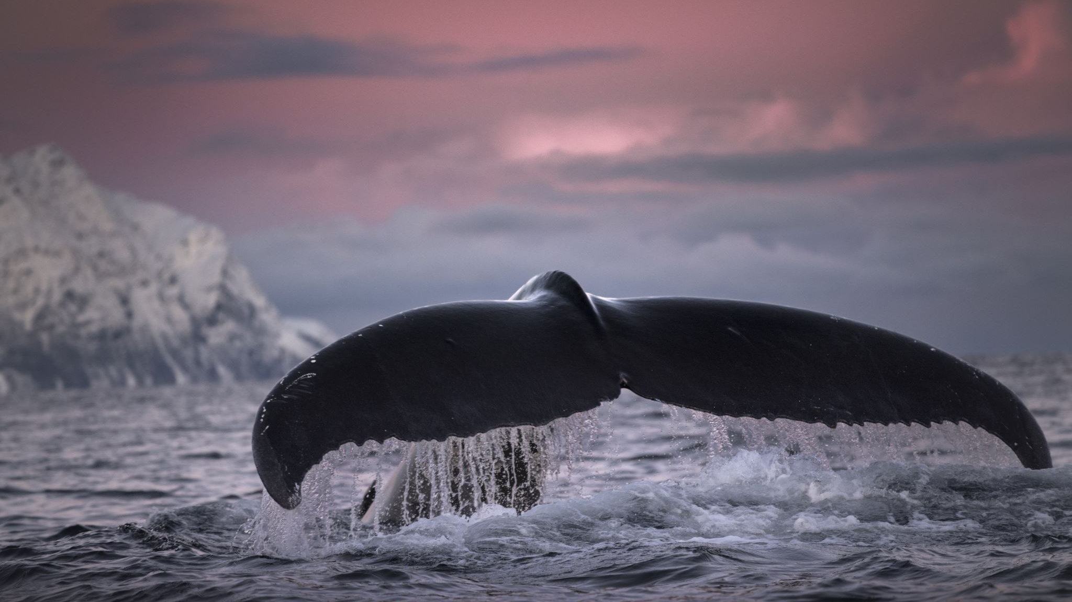
The Trifecta of Whales
Liam the Blue Whale (Project Leader, designed Homepage, Fun Facts, page, wrote article on Moby Dick, general code work)
Mikey the Orca (Responsiveness, responsible for Trending News, About Us Page, general style work)
Jessica the Killer Whale (Responsiveness, Free Willy page, styled pages for consistency, general code work)
While we all have our own pages, everyone helped everyone, which created a lovely smooth process

Slide 4

Key Findings and Persona's
Some of the major findings we had were, News Sites are very popular on Mobile devices, alt text for images is very important for users who need it. Legibility is the number 1 goal, can the site be used only with the Tab and Enter key.
About Edward: Edward is a retired construction worker, he currently only has one working arm due to a bad fall, which broke his left arm, he is currently recovering from this injury. He loves to read interesting news articles from around the world on his computer.
Goal: Edward wants to use his favorite News sites; he enjoys reading these too find out what is happening in the world but needs to find work arounds due to his injury.

Slide 5

Persona Section
About Pat: After taking a year out to save some money, Pat is now enrolled in a journalism course in Limerick, he hopes one day to be writing articles for major news outlets, so he visits news sites often to see how to write a news article. Goal: Take inspiration from these News Sites and apply the knowledge he gained into his course, so Pat must spend a lot of time reading and studying these sites.
About Alisha: Alisha is currently a full-time bartender in a pub in her local town, she often checks the internet for news stories on her break, and in case there is anything she needs to know about, regarding the hospitality sector Goal: Alisha is dyslexic, and struggles to read, she is currently trying to get better at reading, she finds the news articles a great way to help improve her reading, she sees it as killing two birds with one stone, as she learns information and also gets practice in her reading.

Slide 6
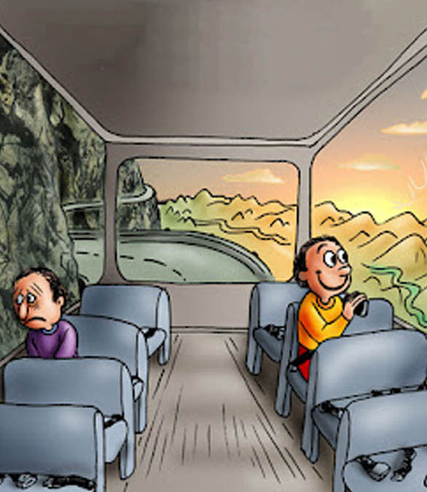
Goals and Value Proposition
Our original value proposition was to have the ability to change the background color to suit the user, this was something that did not make it into our final website.
All pages will have the same Layout.
All pages should use the same Typeface.
Use a font like Roboto which is considered universal.
We will provide sufficient White Space to not overwhelm the user.
We will provide the user with clickable titles that will clearly guide the user to the article they want to read
Our site will follow standard website procedures, for example, the logo in the top left corner taking the user back to the homepage.
We will give our users a fully functional site for Mobile and Desktop.
We will provide the option to the user to choose their own background color, this will be achieved by doing some coding in CSS and JavaScript.
Our users will be able to use the articles we write as a reference in their college reports.

Slide 7
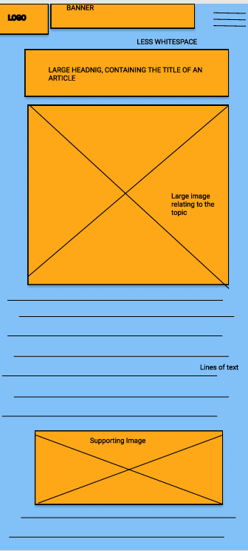
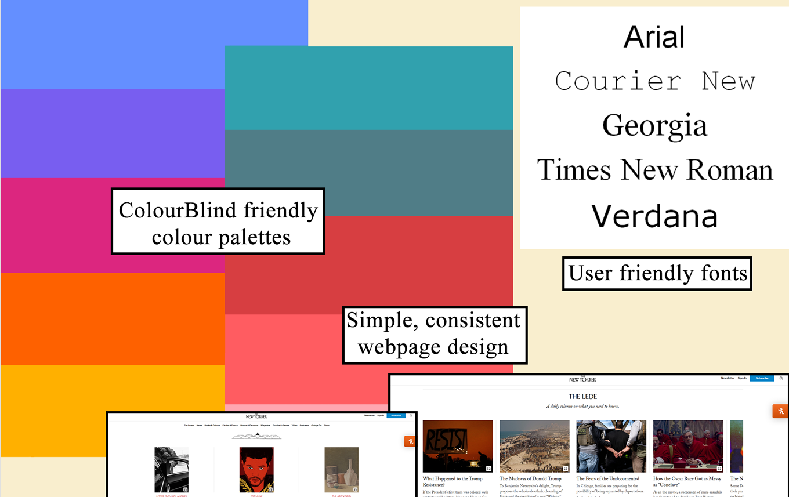
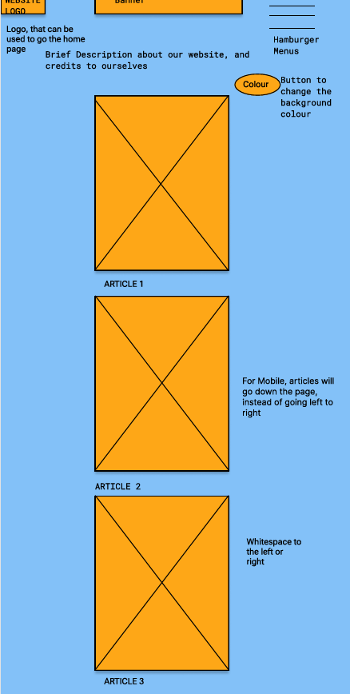
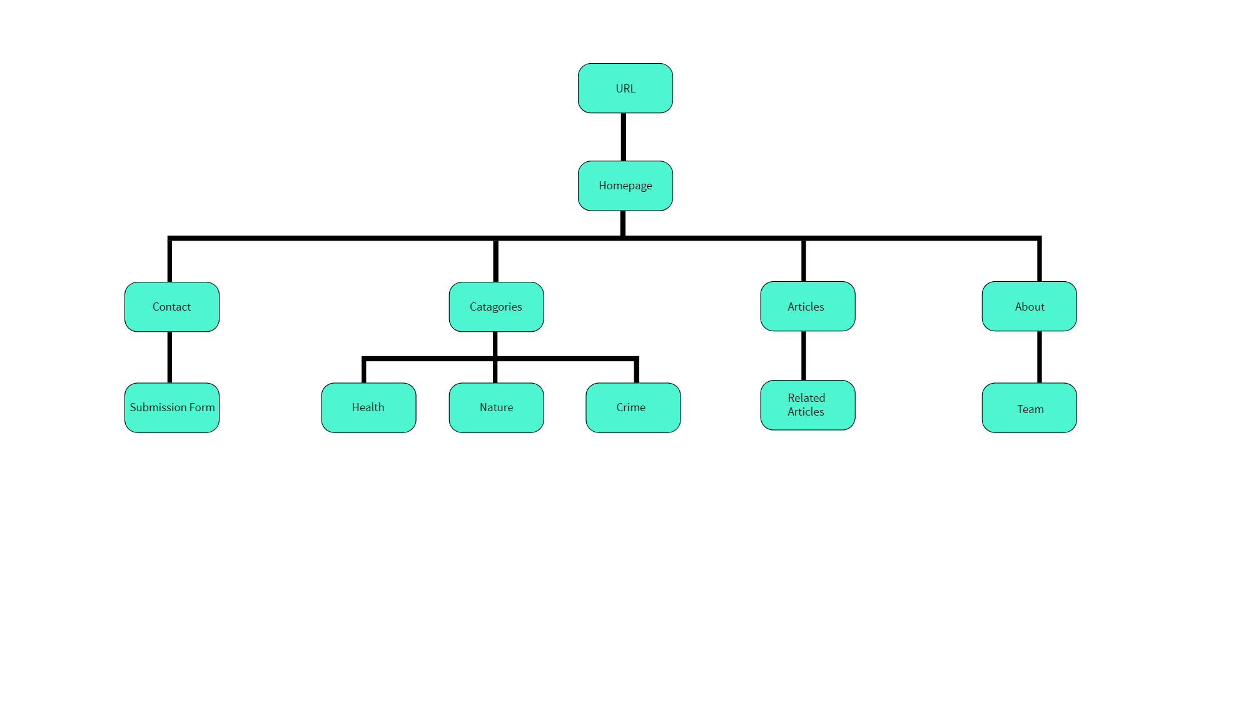
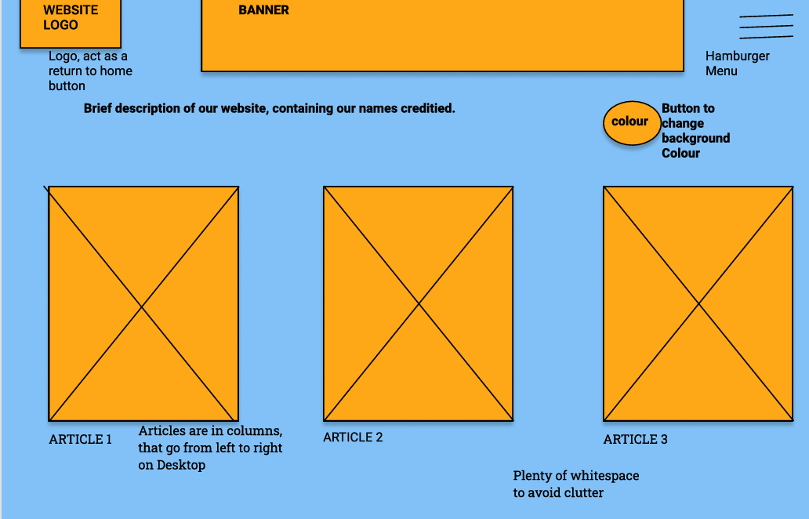
Preliminary Designs & Feedback
Some feedback we received as that our site may be too simple, which is why we tried our best to add as much dynamic elements as we could.
We were also slightly over ambitious with how much we could do.

Slide 8
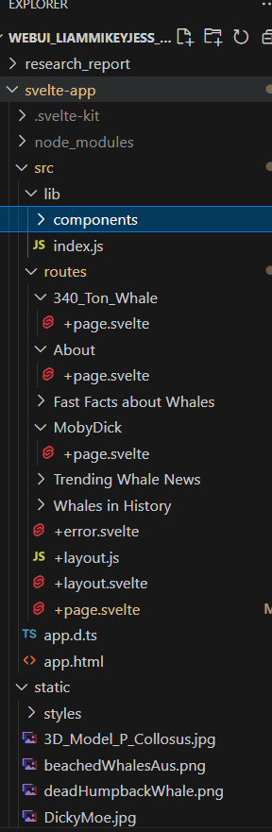
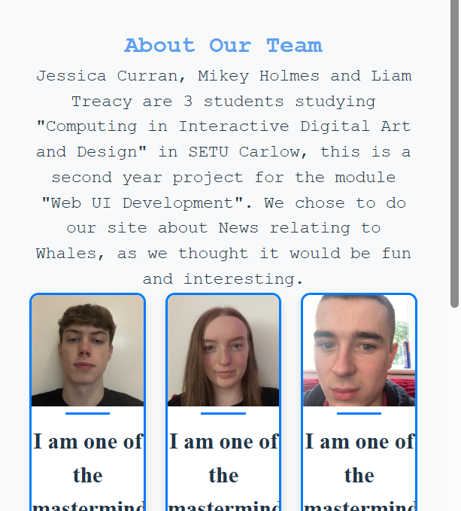
Development & Responsiveness
Like everyone, we used Svelte to construct our site.
We designed with both Desktop and Mobile in mind, we are currently on our final steps to having full responsiveness for mobile, we have large text for Mobile, along with images and cards being adjusted for Mobile also.
E

Slide 9
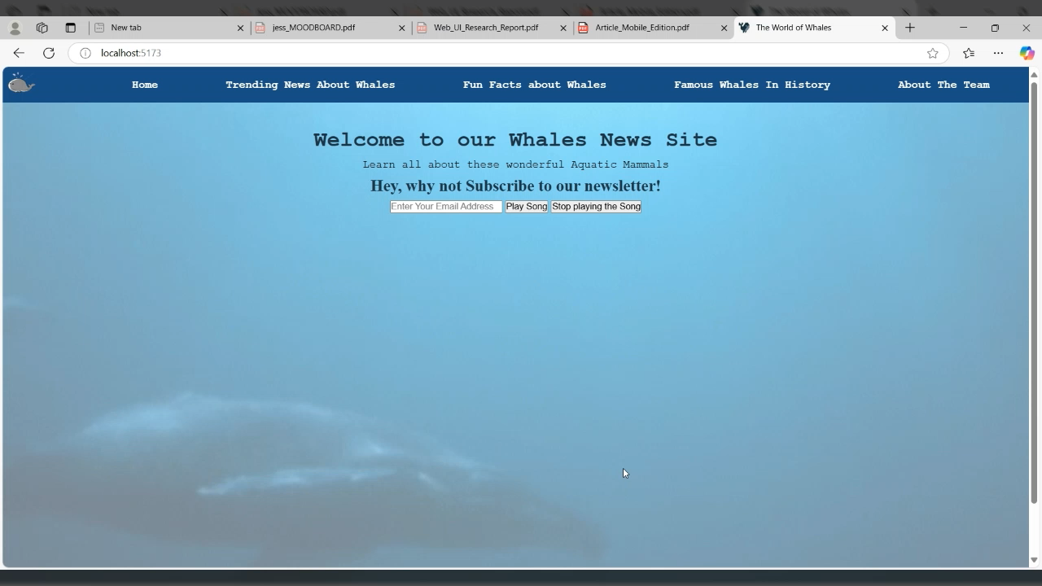
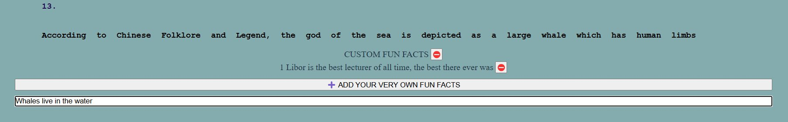
Key Features
Please note, this is an earlier version of our website!!

Slide 10
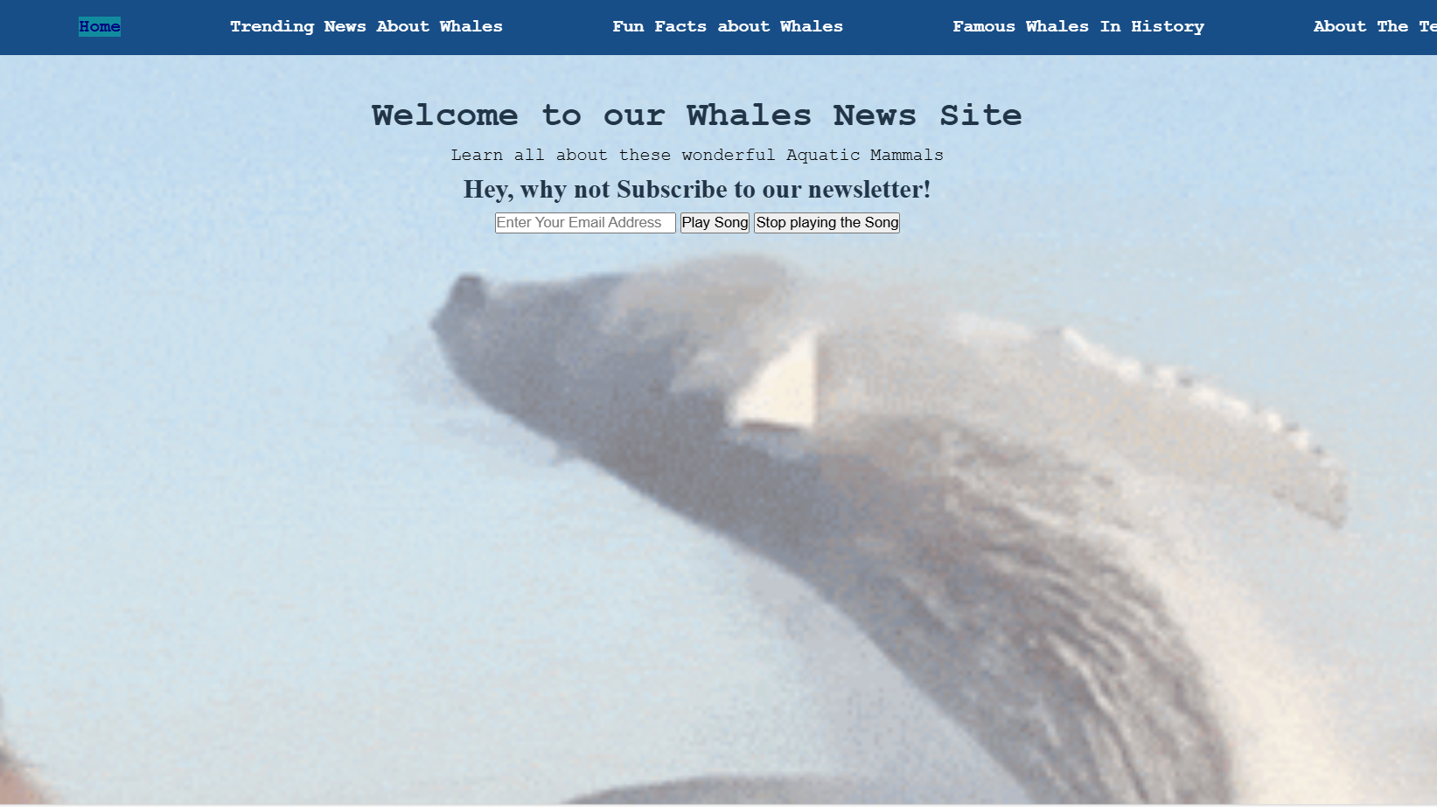
Testing, Optimisation & Deployment
During the process we tested our site both on different sized devices, and we are finishing responsiveness by Thursday. We also had members of our families check the site out and give feedback, some was taken, some was not.
The site runs well and does not appear to have any performance issues. It will be sent out live on April 11th, 2025.
Some of the main Lessons we learned during the whole process was
01. Website development is a lot slower than expected.
02. +Page.svelte is very important
03. Legibility > Style

Slide 11

The Future
For the future, we want this site to be a learning experience for us, on how to manage, develop and maintain a website.
Biggest takeaways are similar to the lessons we just discussed
Enhancements would come in part with more development practice, mainly more articles, more customization and more animation.
We would hope a 2nd year would look worse than a 3rd year attempt and the same for a 4th year attempt.

Slide 12


